Slide 1
Low Fidelity Prototype
Topic: A Visualization Tool for Code-to-Test Traceability

Slide 2
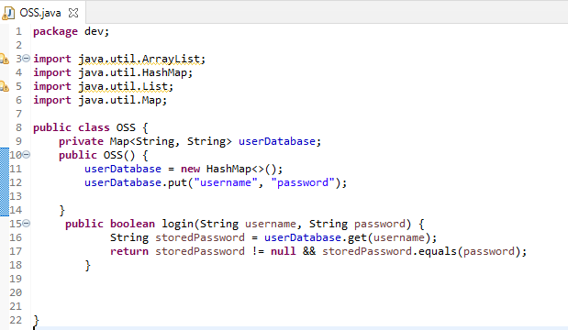
OSS (Online Shopping System) class in Java
Components:
userDatabase: A map to store usernames and passwords.
OSS(): Constructor to initialize the user database with a default username and password.
login(): Method to check if a given username and password match the stored credentials.

Slide 3
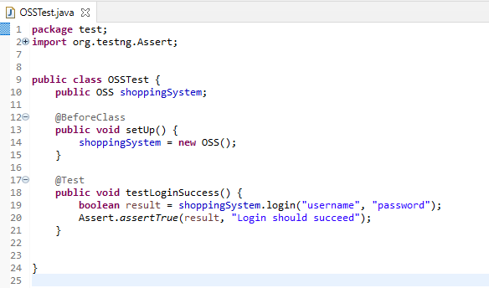
OSSTest class in Java
Components:
shoppingSystem: An instance of the "OSS" (Online Shopping System) class.
testLoginSuccess(): A test method to check if the login with a specific username and password succeeds. It uses the "OSS" instance to perform the login and asserts that the result should be true, indicating a successful login.

Slide 4
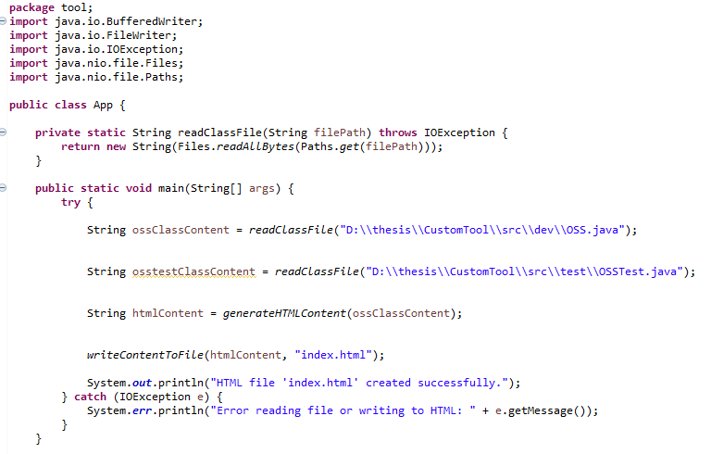
Visualization tool
Components:
readClassFile: Method to read the content of a file given its path.
writeContentToFile: Method to write the HTML content to a file.
main: The main method that orchestrates the process of reading OSS class content, generating HTML, and writing it to a file.

Slide 5
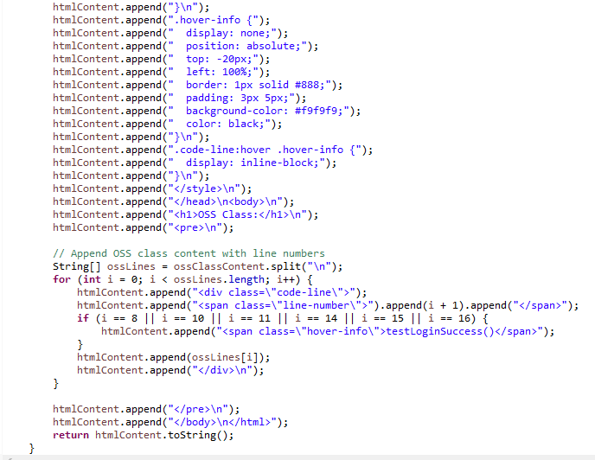
Components:
generateHTMLContent: Method to create HTML content based on the OSS class content.
PS: The if statement to display the text “testLoginSuccess()” is hardcoded to be displayed on the specific lines but in final code it will be dynamic.

Slide 6
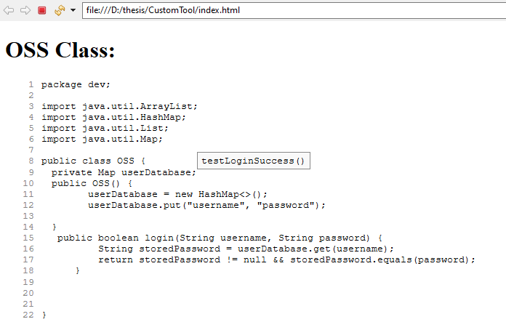
Result
Index.html highlights the usage of variables, statements, and methods defined in the "OSS" class within the "OSSTest" class when the user hovers on the line.
For Eg: In index.html file when user hovers on line 9,11,12 the method name “testLoginSuccess()” of class OSSTest is displayed.

Slide 7
Conclusion
The tool facilitates impact analysis by examining how changes to variables, statements, and methods in the "OSS" class might affect the "OSSTest" class. By identifying and highlighting these dependencies, developers can assess the potential impact of modifications in one class on another, aiding in informed decision-making during the development process.

